Slide 1
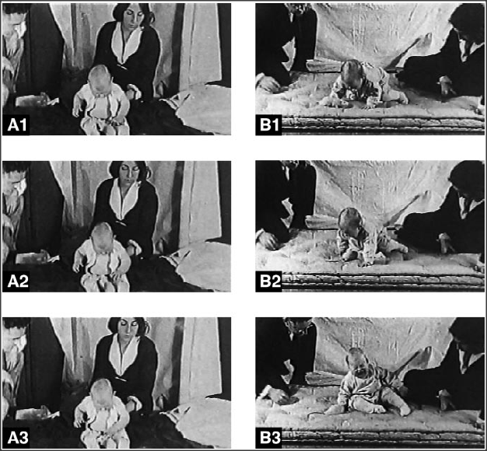
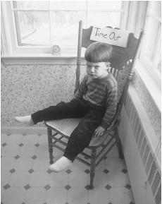
Topic: Learning & Behaviorism
Aim: What are the different ways humans can learn to do things?
Do Now: How would you deal with the following scenario if you were a teacher?
Let’s say kids just won’t go to class – they stand in the hall acting ridiculous all morning – what behavioral techniques could you use to stop that?

Slide 2
Types of Learning
Classical conditioning: learning to link two stimuli in a way that helps us anticipate an event to which we have a reaction
Operant conditioning: changing behavior choices in response to consequences
Cognitive learning: acquiring new behaviors and information through observation and information, rather than by direct experience
Notes:
Automatic animation.
There are millions of sensory neurons and millions of motor neurons, but BILLIONS of interneurons.

Slide 3
How would a person respond in the following scenario…
Someone goes out to a bar to celebrate their 21st birthday with friends. They get ridiculously drunk and sick that night, and feel horrible the next day as well.
What will be their physiological and emotional response when they see/smell alcohol immediately after this night? Why?

Slide 4
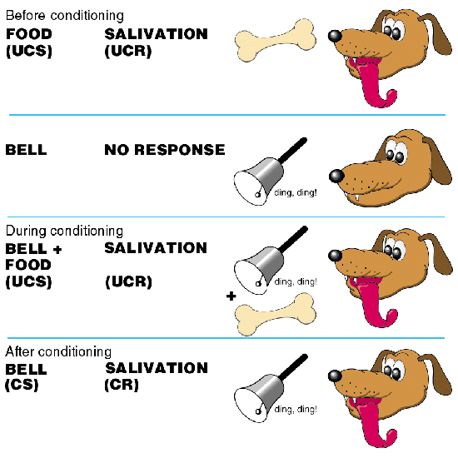
Classical Conditioning
Basic learning process discovered by Pavlov that involves repeatedly pairing a neutral stimulus with a response-producing stimulus until the neutral stimulus triggers the same response

Slide 5
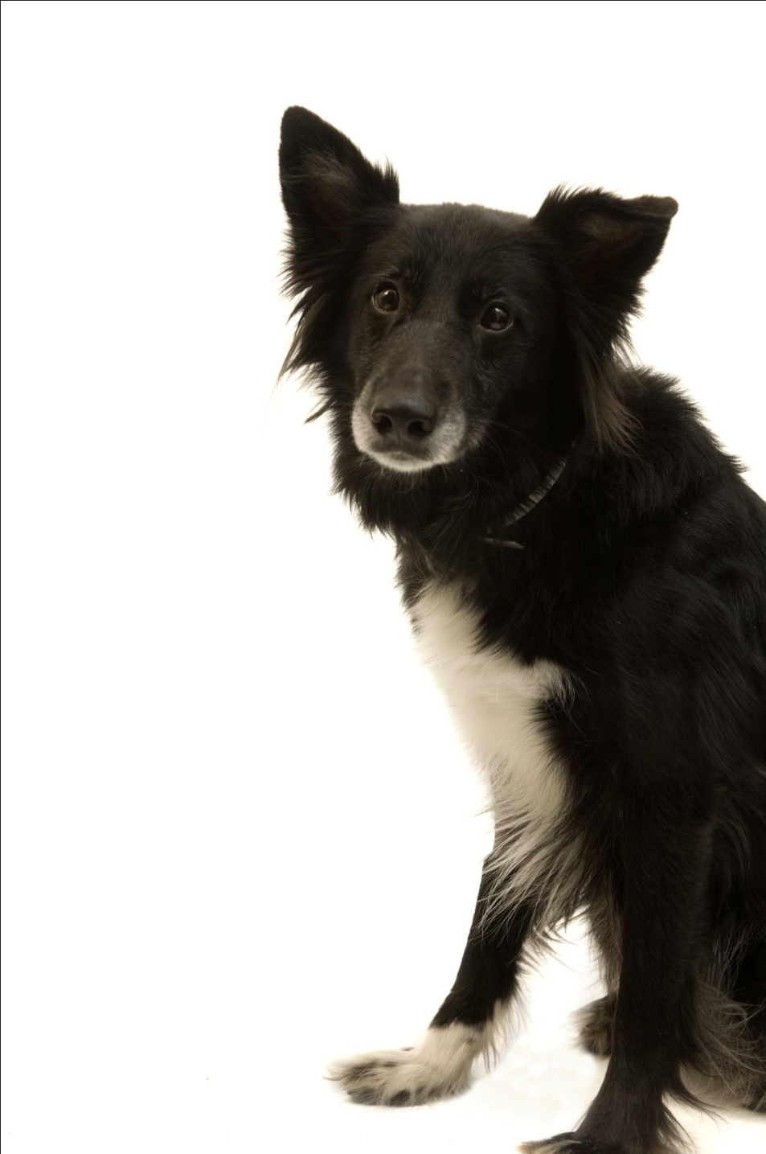
While studying salivation in dogs, Ivan Pavlov found that salivation from eating food was eventually triggered by what should have been neutral stimuli such as:
  just seeing the food.
  seeing the dish.
  seeing the person who brought the food.
  just hearing that person’s footsteps.
Notes:
Click to reveal bullets.
Instructor, you can add verbally:
“The dog had learned that these stimuli predicted the arrival food. These neutral stimuli had become conditioned stimuli.”
Ivan Pavlov then performed controlled experiments yielding much of the knowledge about conditioning still used today.

Slide 6

Before Conditioning
Neutral stimulus:
a stimulus which does not trigger a response
Neutral
stimulus (NS)
No response
Notes:
Click to start animation.

Slide 7
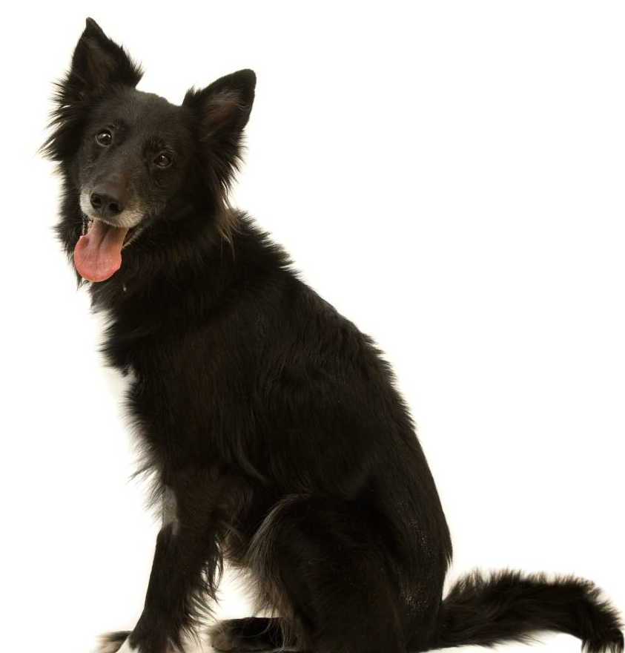
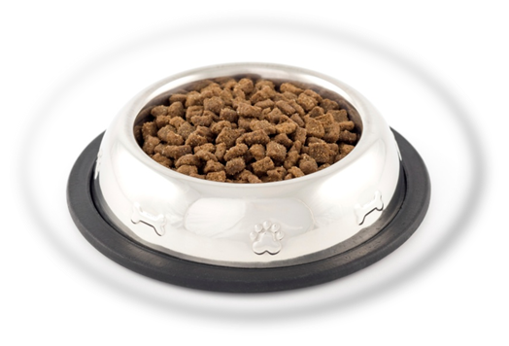
Before Conditioning
Unconditioned stimulus and response:
a stimulus which triggers a response naturally,
before/without any conditioning
Unconditioned response (UR):
dog salivates
Unconditioned
stimulus (US): yummy dog food
Notes:
Click to start animation.
Ivan Pavlov’s dogs exhibited salivation (UR) in response to food (US).

Slide 8
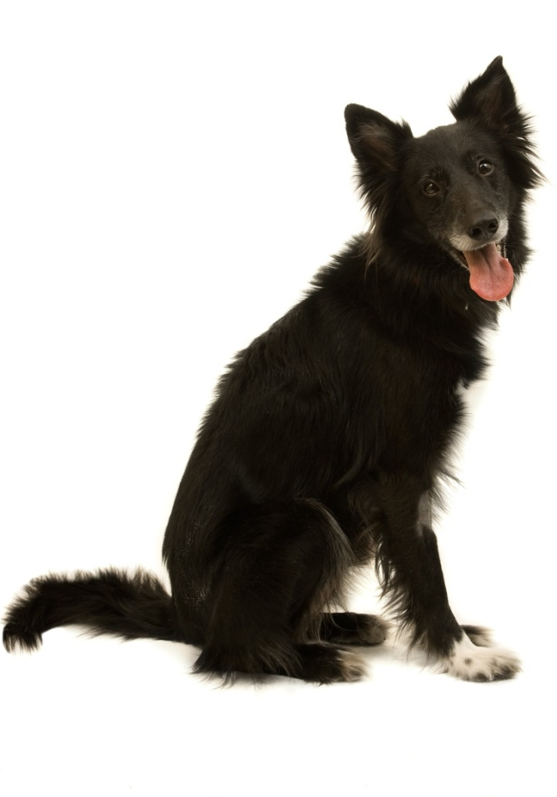


During Conditioning
The bell/tone (N.S.) is repeatedly presented with the food (U.S.).
Neutral
stimulus (NS)
Unconditioned response (UR):
dog salivates
Unconditioned
stimulus (US)
Notes:
Click to start animation.
Ivan Pavlov then presented a tone (NS) just before presenting the food (US).
APA Learning Goal 1: Knowledge Base of Psychology

Slide 9
After Conditioning
The dog begins to salivate upon hearing the tone (neutral stimulus becomes conditioned stimulus).
Did you follow the changes?
The UR and the CR are the same response, triggered by different events.
  The difference is whether conditioning was necessary for the response to happen.
The NS and the CS are the same stimulus.
  The difference is whether the stimulus triggers the conditioned response.
Conditioned response:
dog salivates
Conditioned (formerly neutral)
stimulus
Notes:
Click to start animation. Click again to show recap.
After a few pairings, the NS (tone) became a CS, and it was able to produce a CR (salivation) by itself.

Slide 10
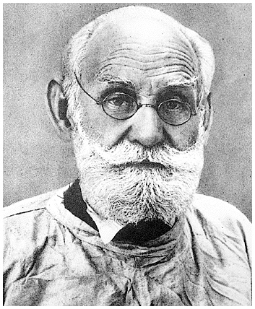
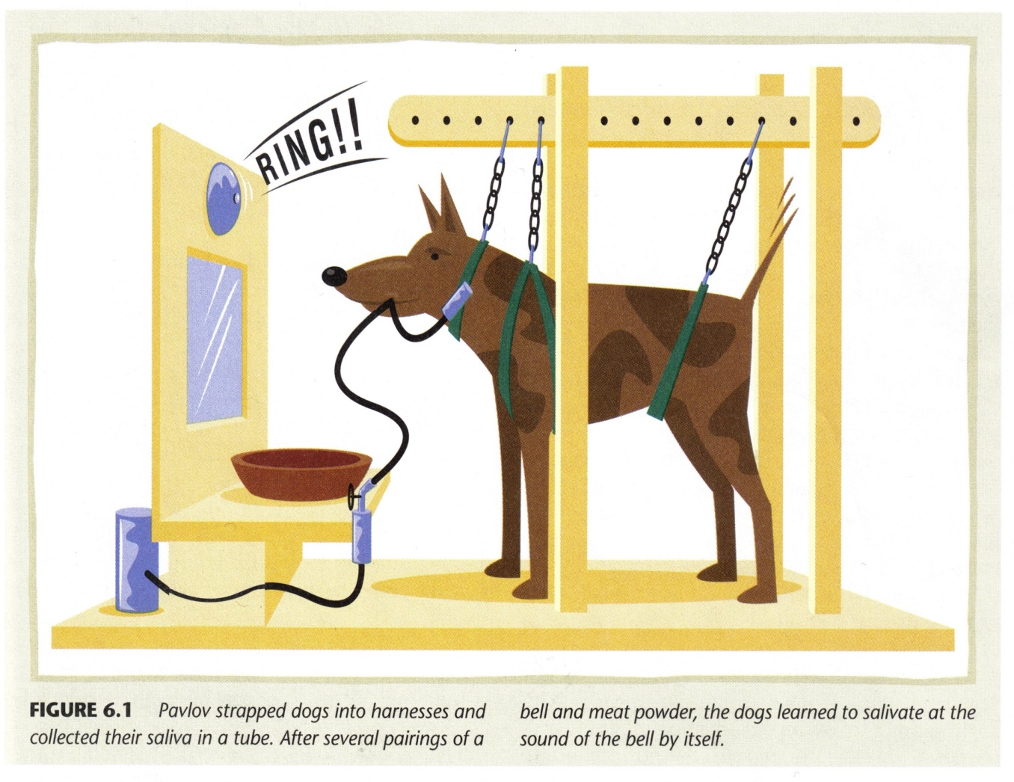
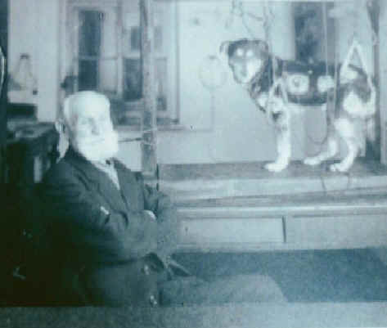
Ivan Pavlov

Slide 11
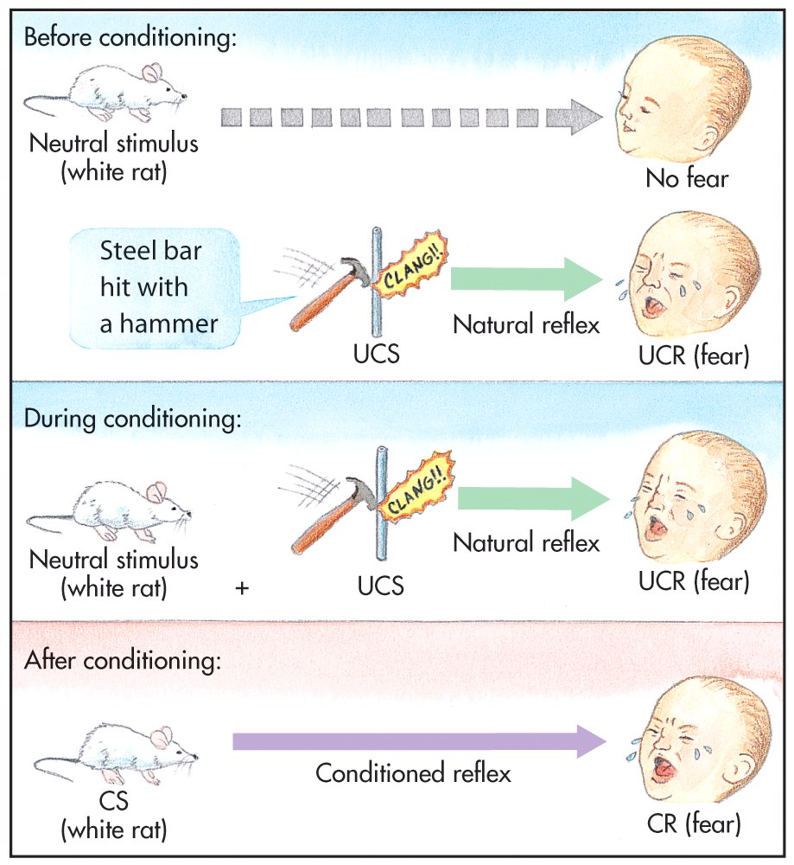

Slide 12
Other Examples…
Can you think of any other examples where a stimulus (a sound, smell, taste, etc.) immediately reminds you of something good or bad, and causes you to have an emotional or physiological response?

Slide 13
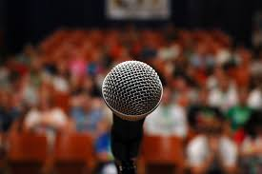
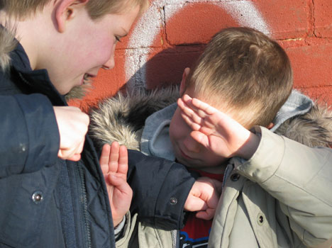
Classroom Examples:
A first grader feels ill when recess time approaches because he was beat up on the playground the last 3 days in a row.
Certain smells that can elicit nauseous sensations (Hopefully NOT from the cafeteria!)
Speech phobia: cold sweat, shaking knees and hands

Slide 14
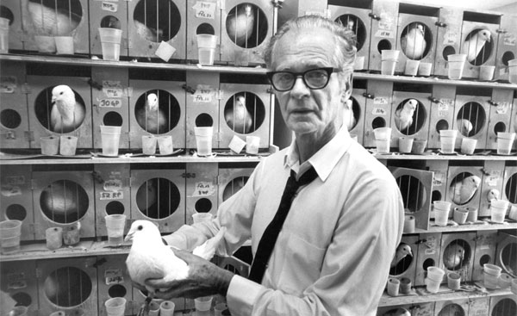
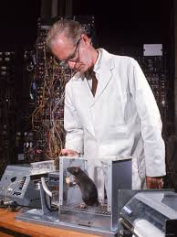
Operant Conditioning (B.F. Skinner):
“All we need to know in order to describe and explain behavior is this: actions followed by good outcomes are likely to recur , and actions followed by bad outcomes are less likely to recur.” (Skinner, 1953)
The type of learning in which behaviors are emitted to earn rewards or avoid punishments
In classical conditioning the response to the stimulus was automatic. In operant conditioning the participant operates on the environment to gain something desired or avoid something unpleasant.

Slide 15
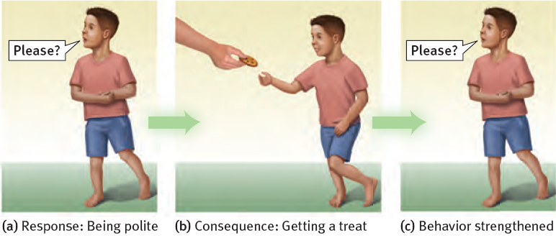
  Child associates his “response” (behavior) with consequences.
  learns to repeat behaviors (saying “please”) which were followed by desirable results (cookie).
  Child learns to avoid behaviors (yelling “gimme!”) which were followed by undesirable results (scolding or loss of dessert).
Notes:
No animation.

Slide 16
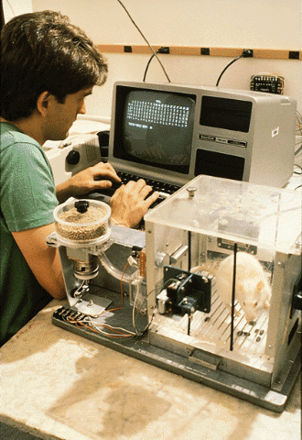
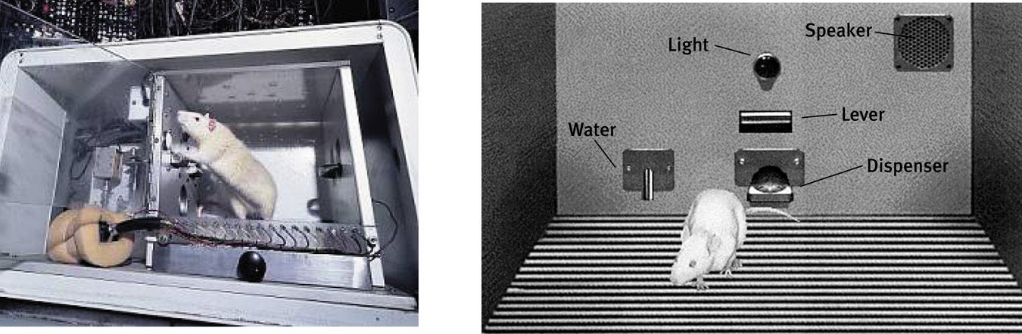
The “Skinner Box”
The operant chamber, or Skinner box, comes with a bar or key that an animal manipulates to obtain a reinforcer like food or water. The bar or key is connected to devices that record the animal’s response.

Slide 17
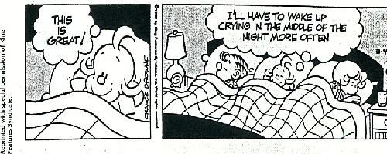
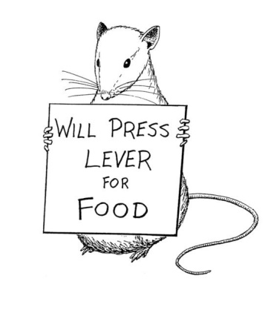
Types of Reinforcement:
Reinforcer: A stimulus or event that follows a behavior and makes that behavior more likely to occur again
Positive: Adds something rewarding following a behavior, making that behavior more likely to occur again
  Giving a dog a treat for fetching a ball is an example (OTHER EXAMPLES???)
Negative: Removes something unpleasant that was already in the environment following a behavior, making that behavior more likely to occur again (a baby cries until we pick them up, your car beeps until you put you seatbelt on, a teacher flashes the classroom lights on and off until the class quiets down, etc.)

Slide 18
Punishment:
An aversive event that decreases the behavior it follows.
Many people confuse negative reinforcement and punishment.
Negative Reinforcement always increases behavior
Punishment always decreases
Notes:
OBJECTIVE 15| Discuss the ways negative punishment, positive punishment, and negative reinforcement differ, and list some drawbacks of punishment as a behavior-control technique.

Slide 19
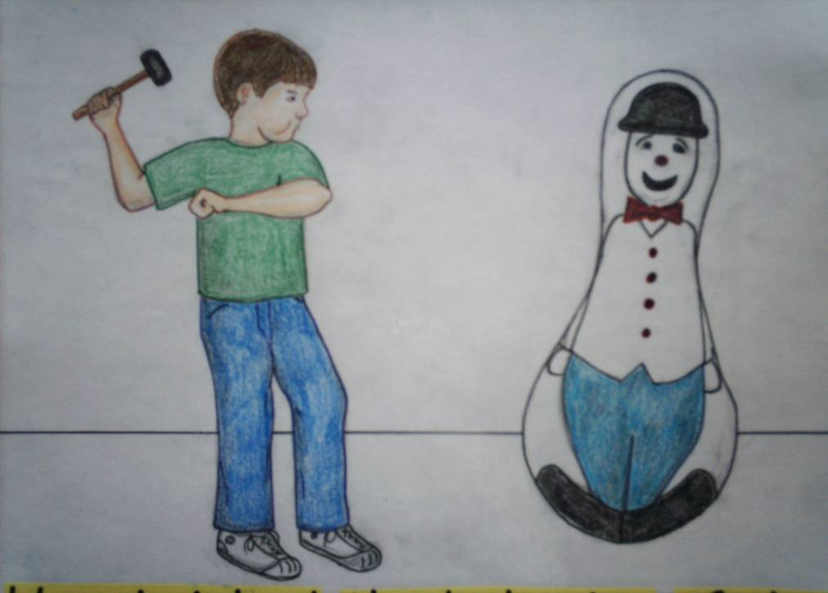
Observation Learning Theory:
We learn through observing our environment.
EX: When walk in a room how do we decide how to behave? How do we know what to wear, where to sit, what to do?
Fears can be acquired by observational learning

Slide 20
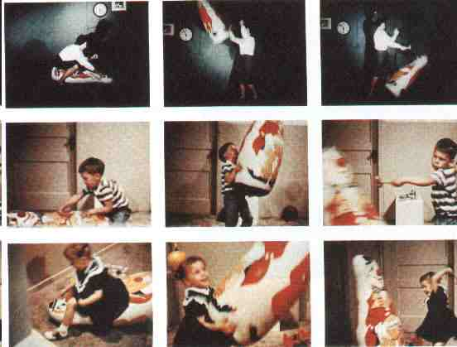
Bobo Doll Experiment

Slide 21
http://www.youtube.com/watch?v=hHHdovKHDNU

Slide 22
4 Cognitive Processes that determine whether imitation will occur:
Paying attention to the other person’s behavior
Forming and storing mental representations of the behavior to be imitated
Transforming this mental representation into actions you are capable of reproducing
And, being motivated to imitate the behavior by some expectation of reinforcement or reward

Slide 23
Behavior Modification Activity - for each of the 5 scenarios, pretend that you are have to help the person in the scenario change whatever behavior is described.

